Slide 1




Energy Modeling Optimization
The Process of Using Telemetry to Its Fullest Potential
Shannon Caraway, P.E.
1/18/25

Slide 2
The Path From Telemetry To Full Energy Modeling Optimization
The 2023 workshop had an excellent telemetry presentation by the former Okemos Solar Car Team
  It covered what telemetry is, why it is important, collecting data, etc.
  I encourage you to check it out
Each solar car’s telemetry hardware specifics will likely be unique
  This is due to the fact that there is a wide team to team variation on which charge controller, motor controller, and battery is being used
  The process we have used and is being described today was successfully applied to both an Outback Power Systems (U.S.) and iPanda Galaxy (China)
  In both cases, these systems gather much of the needed data
Which data is needed and for what purpose
  Power Consumption → key inputs of power consumed vs speed
  Solar Production → key inputs of solar energy production vs GHI
  Battery Energy → how much energy is currently in the battery
Optimization
  With the above information, full parameterization of the car is possible
  Applying solar irradiance forecasting allows optimal speed determination

Slide 3
Data Gathered From
2021 Solar Car Challenge
& The Insights Gained

Slide 4
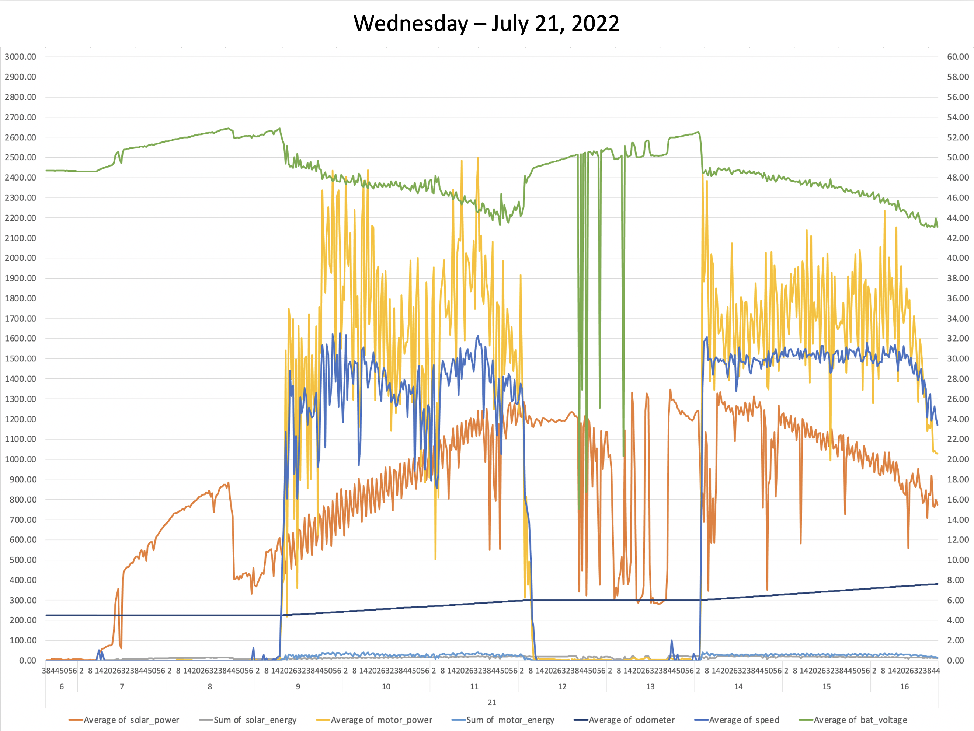
Data Gathered From 2021 Solar Car Challenge
Wednesday – July 21, 2021

Slide 5
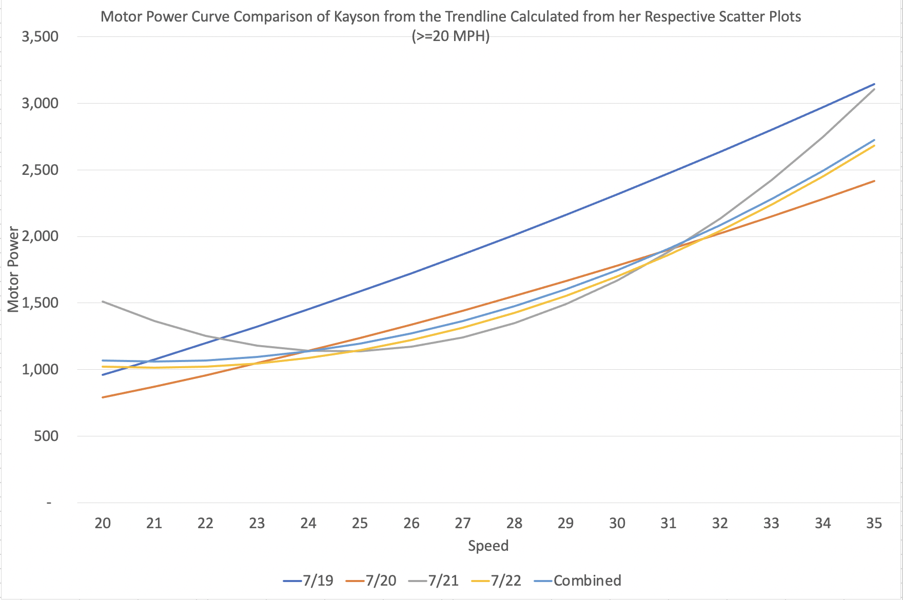
Motor Power Curve Comparison of Team Captain Over Four Days of Driving (>20 MPH)

Slide 6
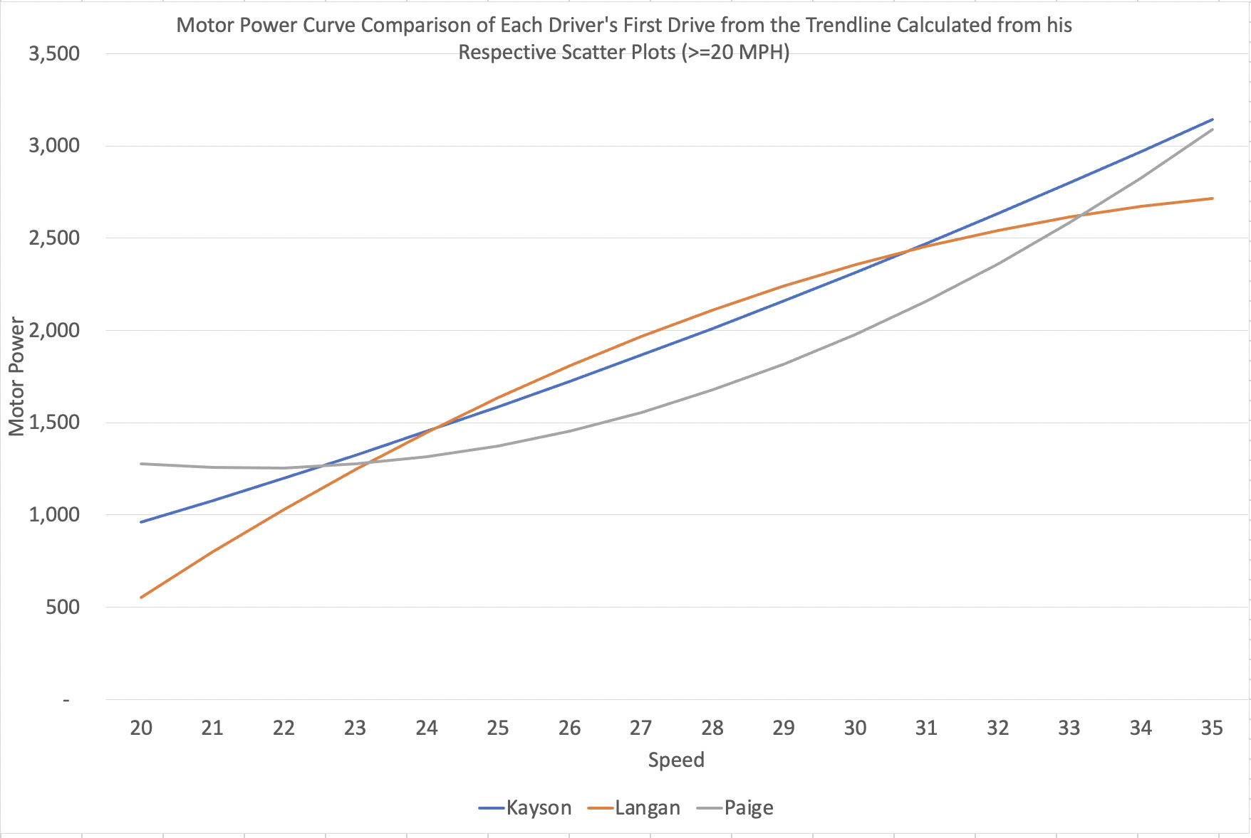
Driver 1
Driver 2
Driver 3

Slide 7
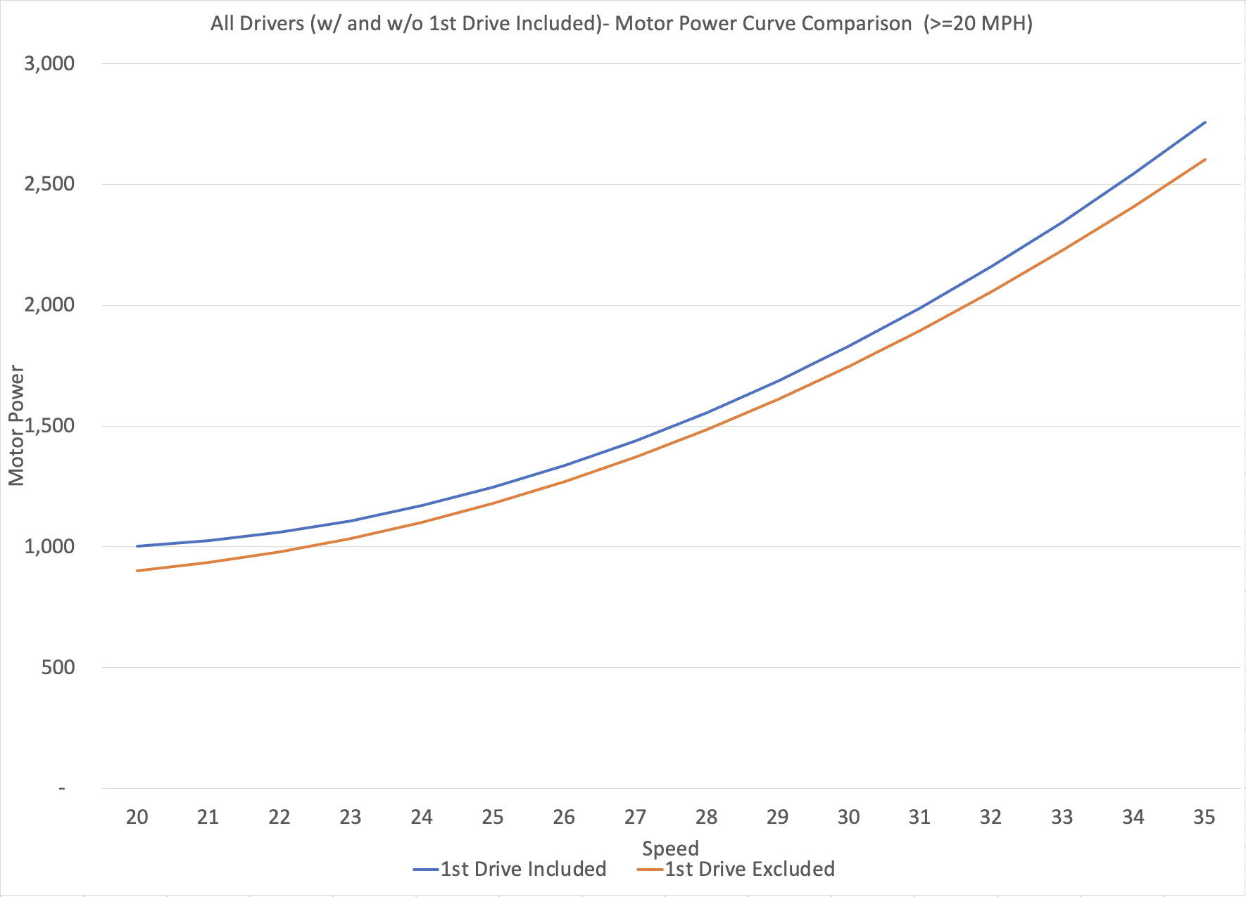

Slide 8
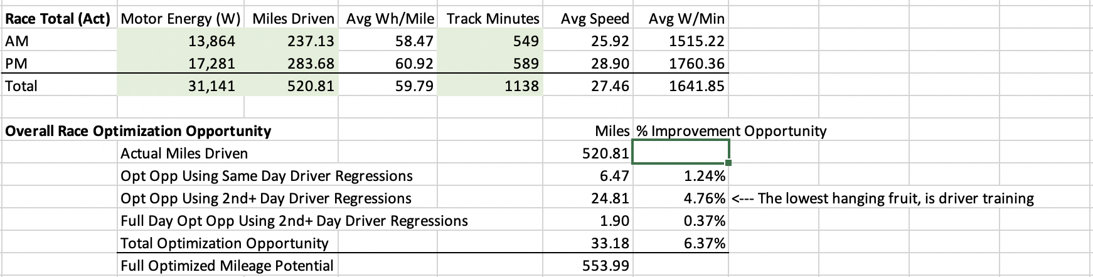
Complete 2021 Race Stats and Summary of Optimization Opportunity

Slide 9
Parameterization of Your Solar Car and the Optimization Possibilities

Slide 10
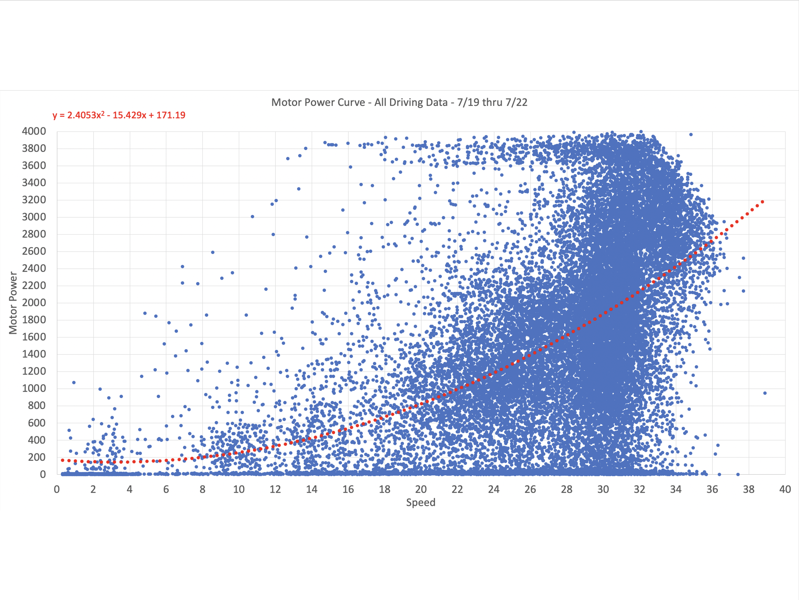

Power Consumption

Slide 11
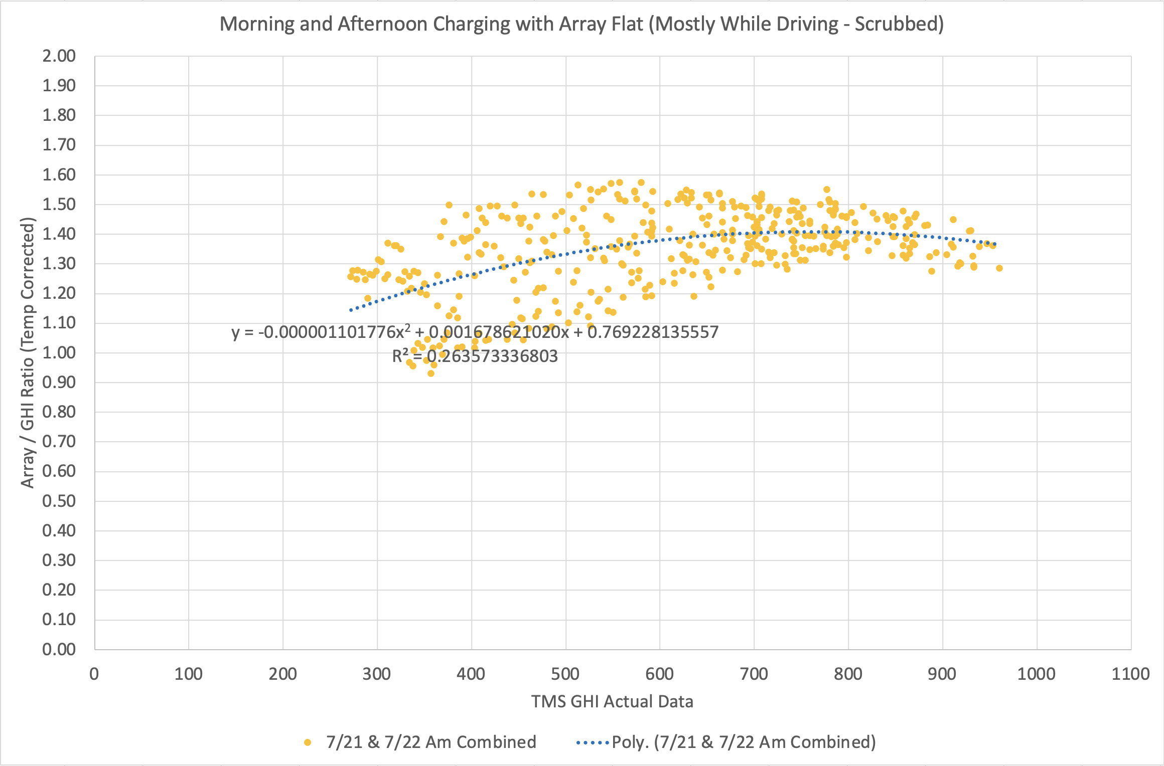
Solar Production During The Race (Array In Flat Orientation)

Slide 12
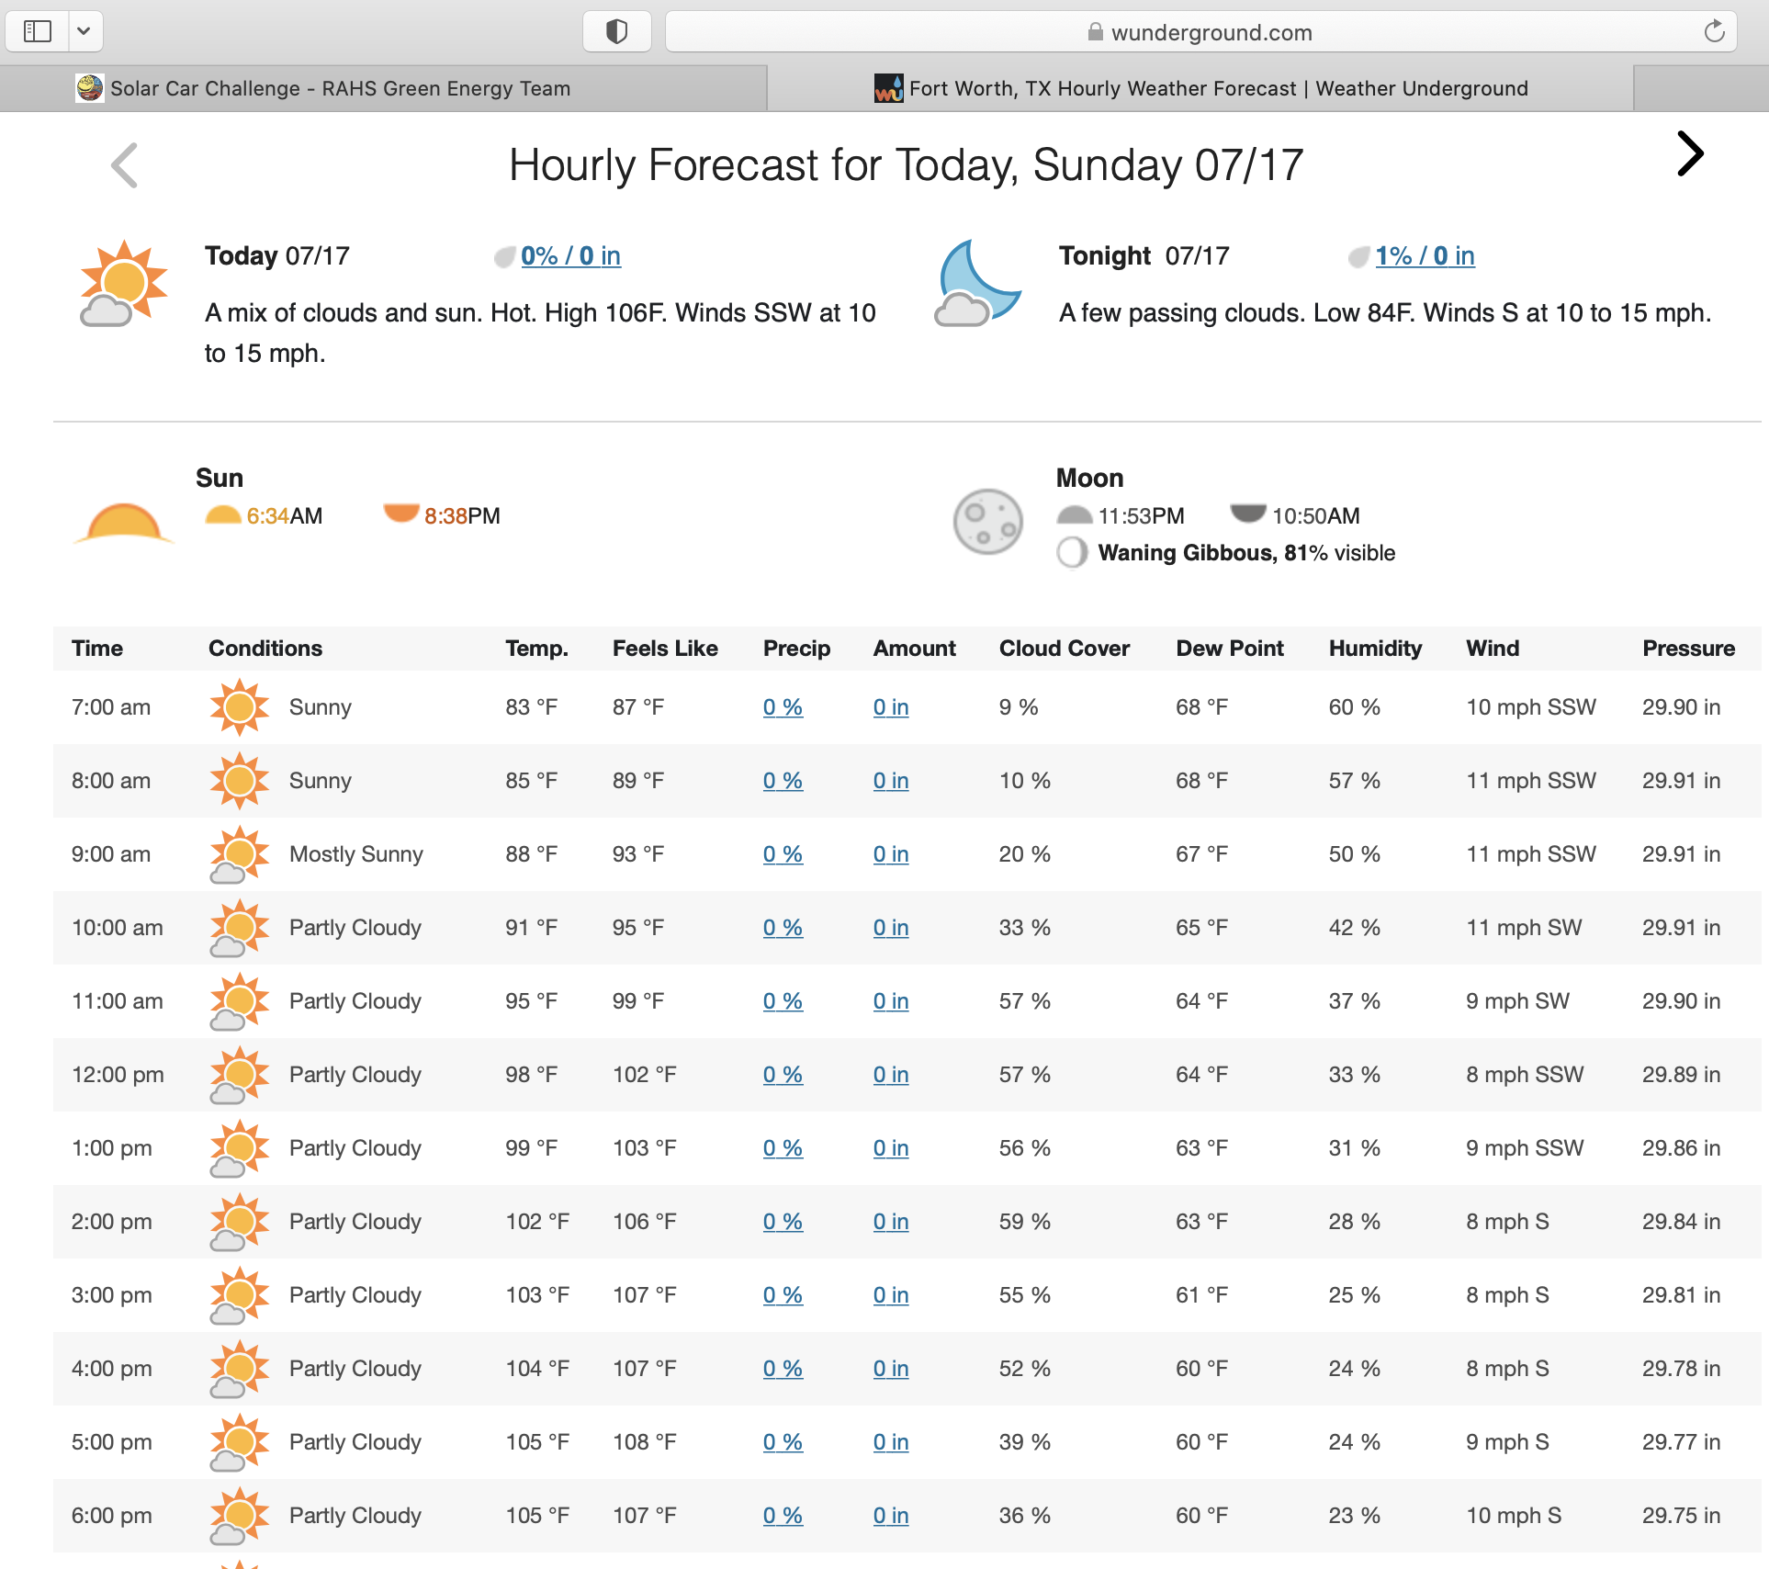
Typically Available Weather Forecasting

Slide 13
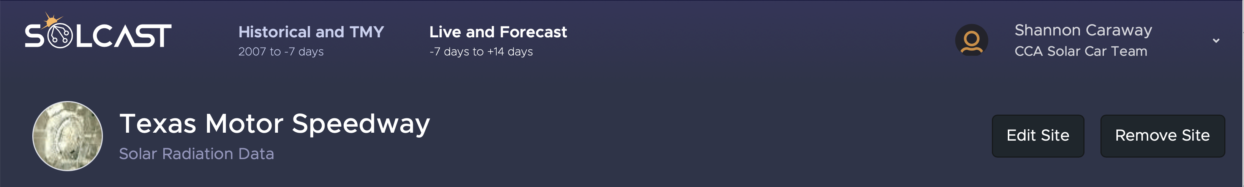
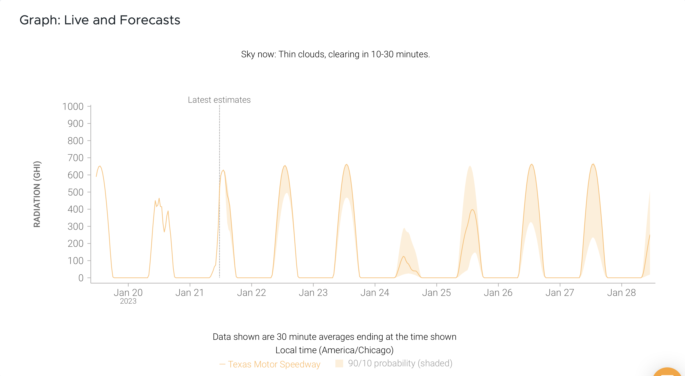
The Type of Weather Forecasting Needed for Optimization

Slide 14
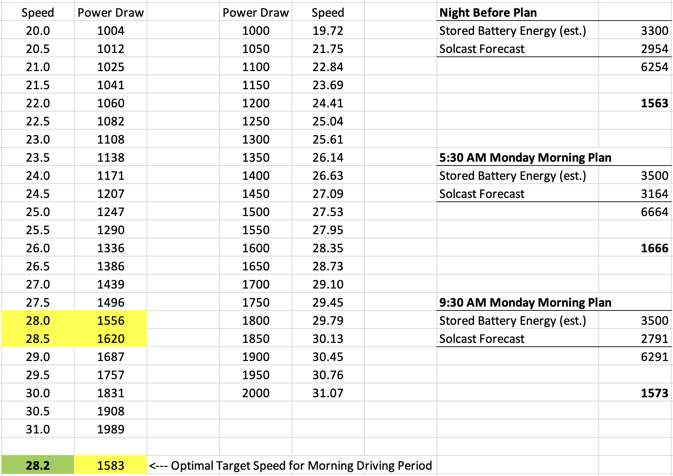
Bringing It All Together for the 2022 Solar Car Challenge

Slide 15
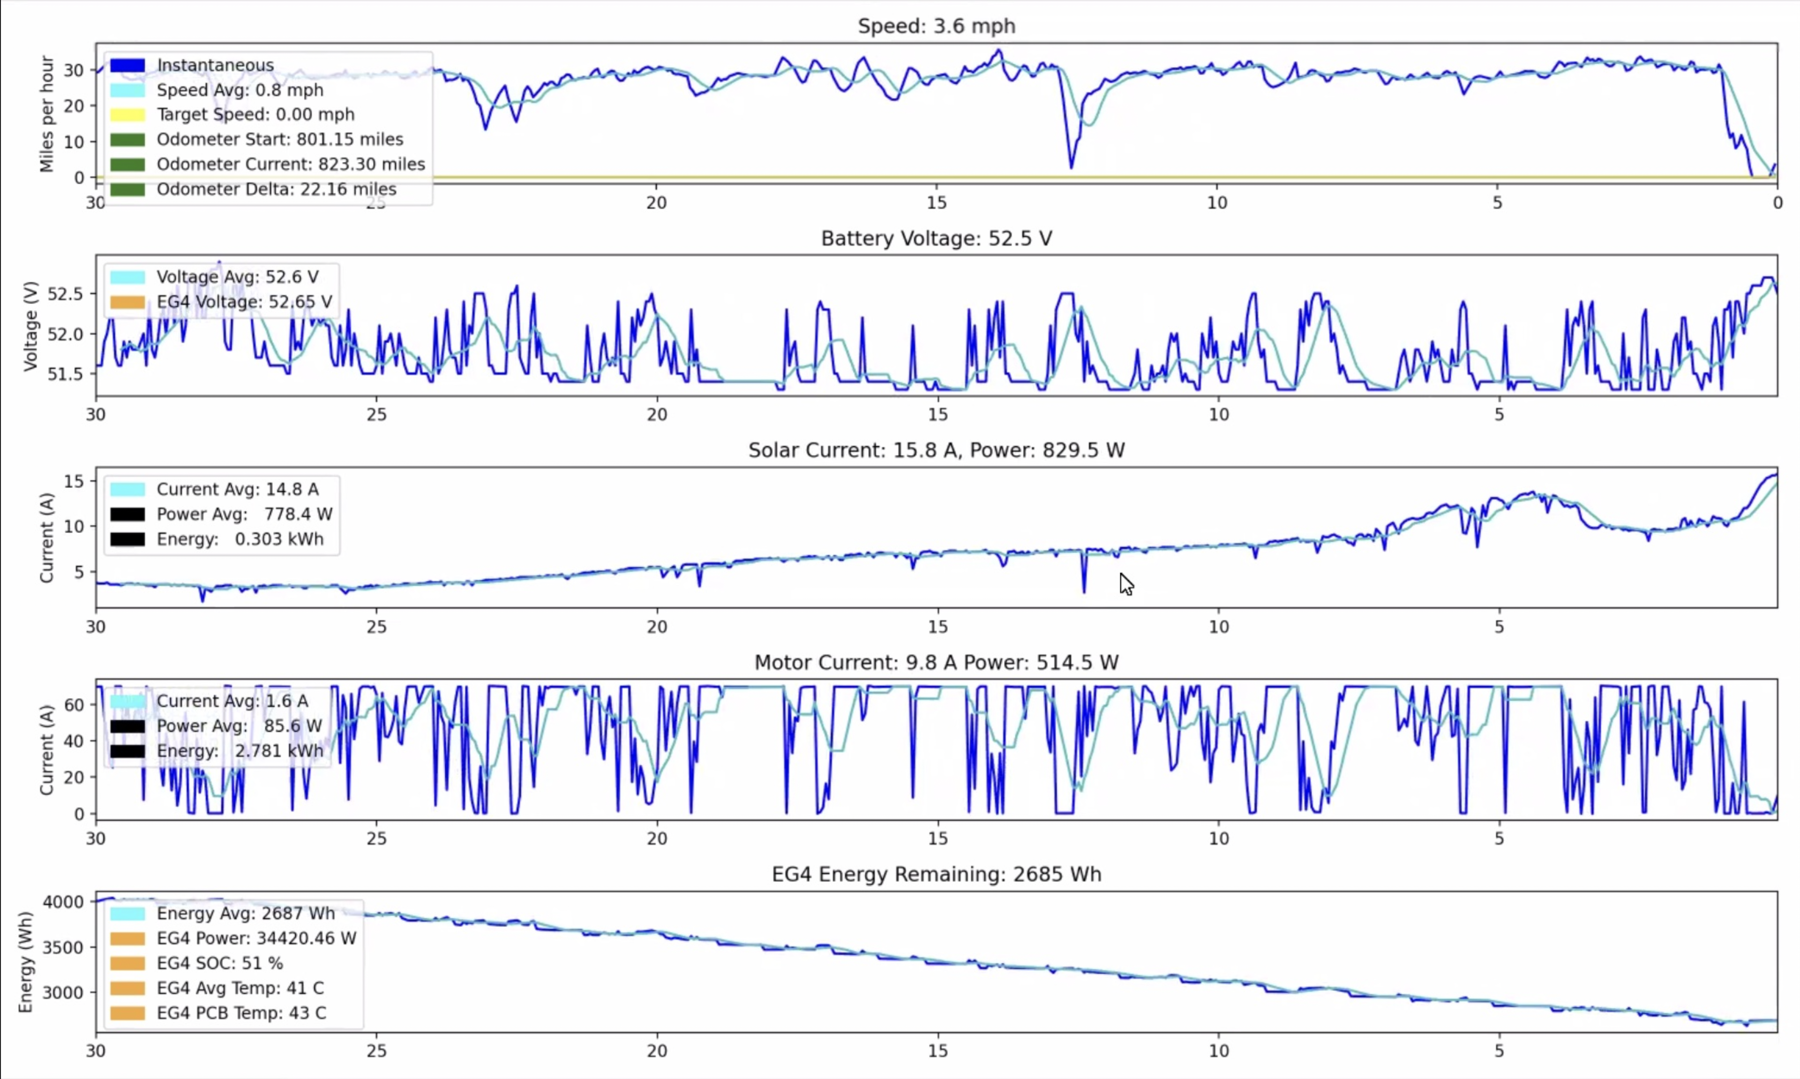
Importance Of Real Time Visualization Tool (Your Dashboard)

Slide 16
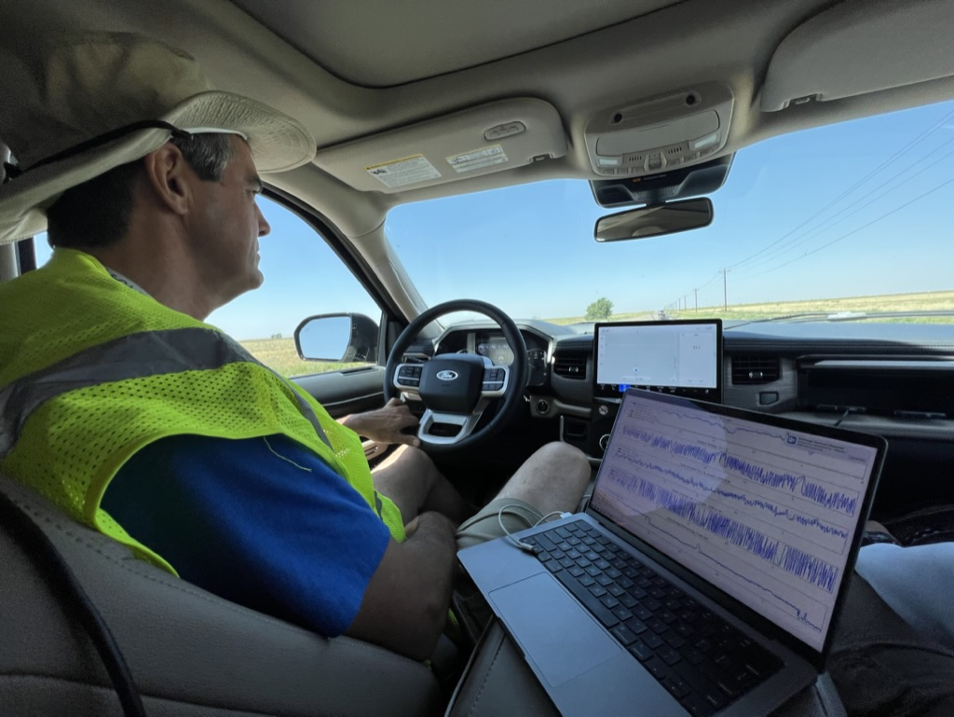
Application During 2023 Solar Car Challenge Cross Country Race

Slide 17
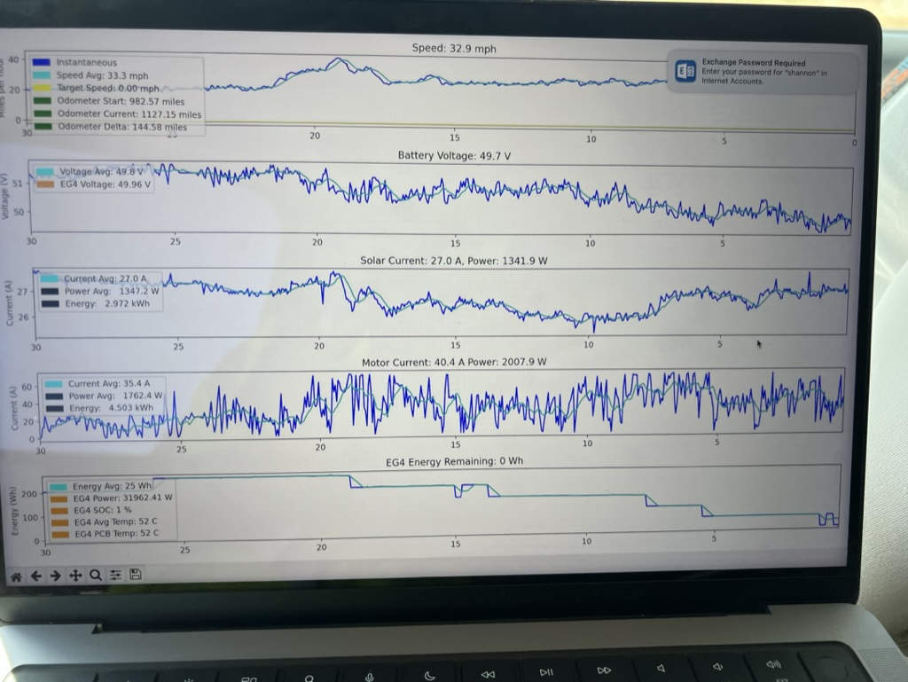
The Pinnacle of the CCA Solar Car Team Energy Optimization
Snyder, TX to Carlsbad, NM (Screen Shot at 4:02 PM on July 17, 2023)
For the first time in our team’s history, we finally had all the pieces in place to develop a daily energy optimization strategy, confidently use every last kWh from the battery, and make SCC history for the most miles driven on this leg of the race.

Slide 18
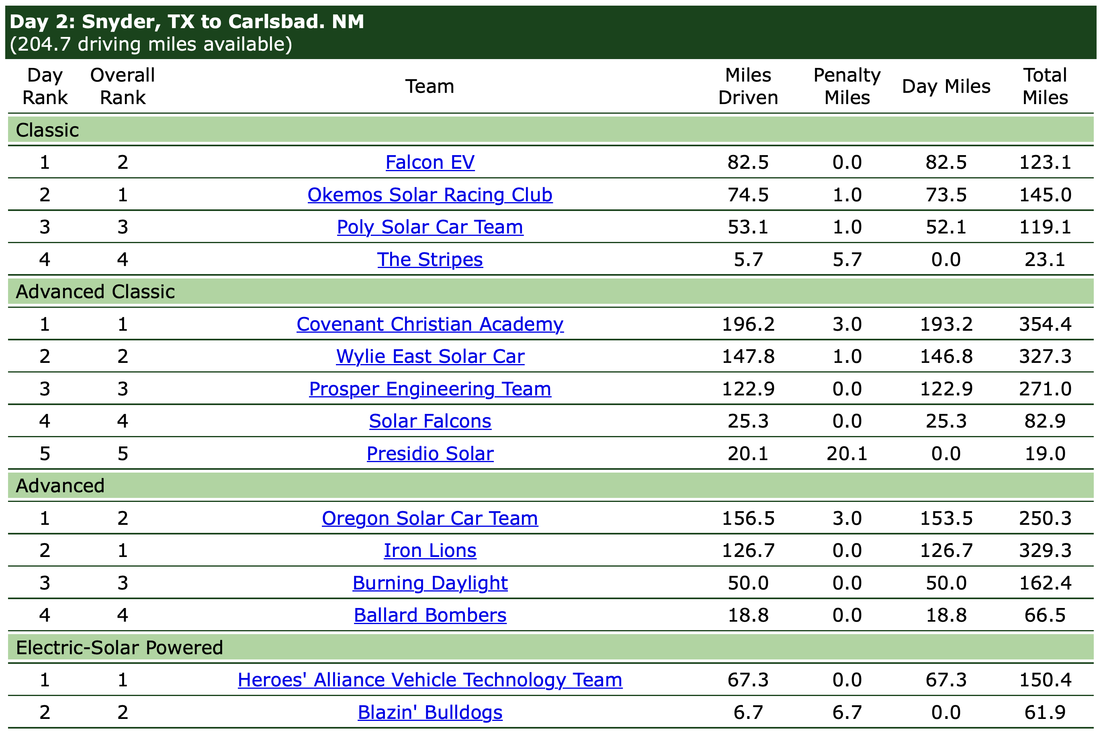
The Pinnacle of the CCA Solar Car Team Energy Optimization
Snyder, TX to Carlsbad, NM – Record Breaking Distance Achieved!
The prior distance record for the Snyder, TX to Carlsbad, NM leg of the Solar Car Challenge was 169.6 miles, set by the Houston Solar Race Team in 2018 and that was a solar car racing in the Advanced Division, rather than Advanced Classic Division.

Slide 19
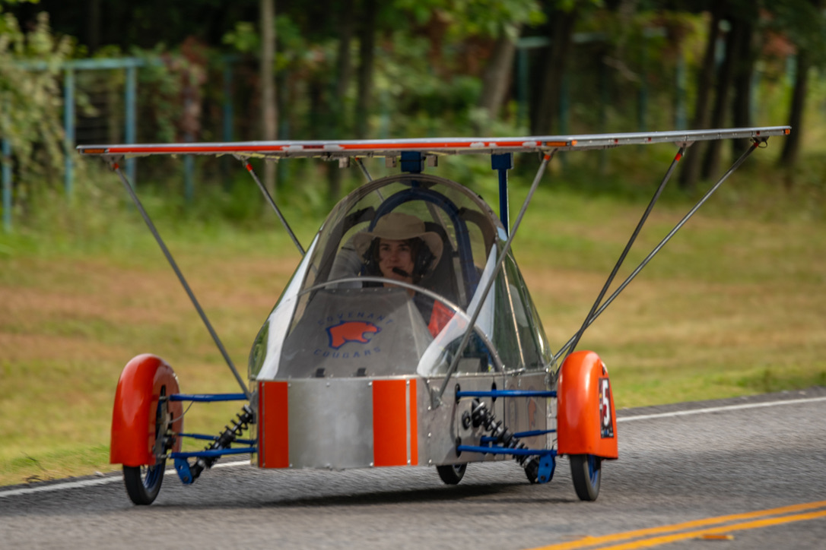
Energy Modeling Optimization Allows The Maximum Performance To Be Extracted From A Given Solar Car Design
If you have questions about Energy Modeling Optimization for your solar car, please feel free to contact me: email - swcaraway68@gmail.com, phone - 214-478-6009

